Slide 1
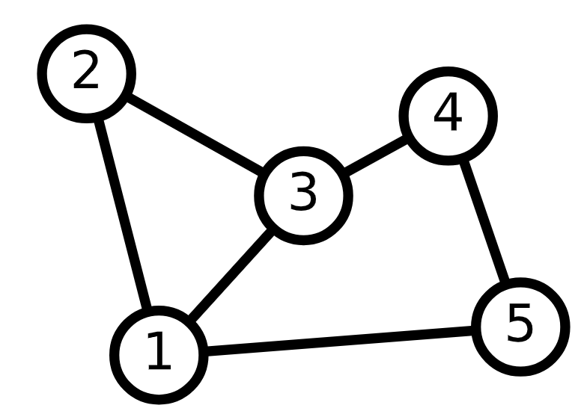
Graphs in the era of Neural Networks

Slide 2
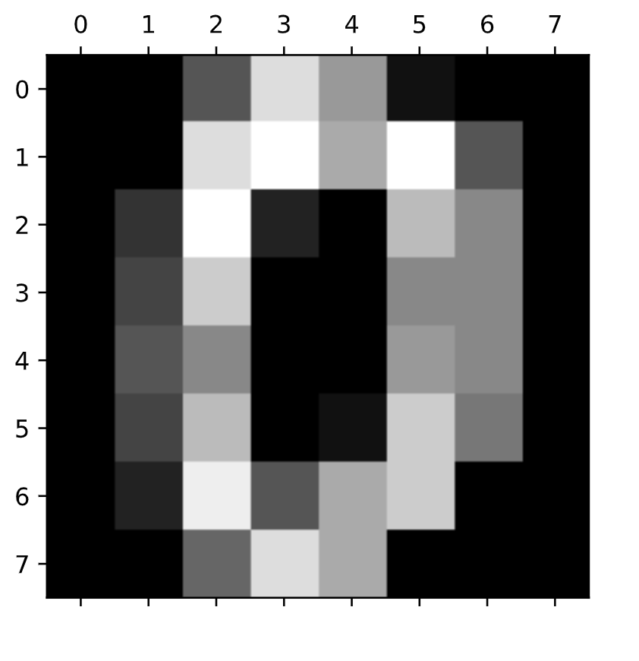
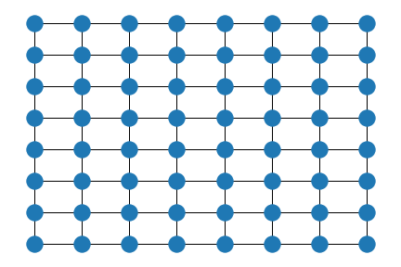
(almost) everything is a graph
G = nx.grid_2d_graph(8, 8)

Slide 3

What was the central component behind CNN?
https://glassboxmedicine.com/2020/08/03/convolutional-neural-networks-cnns-in-5-minutes/

Slide 4
The convolution operator defines a graph
The filter

Slide 5
What are graphs?
V, a set of vertices (nodes)
E, a set of edges (edges)
G = nx.Graph()
G.add_edge(1, 2)
G.add_edge(1, 3)
G.add_edge(1, 5)
G.add_edge(2, 3)
G.add_edge(3, 4)
G.add_edge(4, 5)
graph
*graphs can also be directed

Slide 6
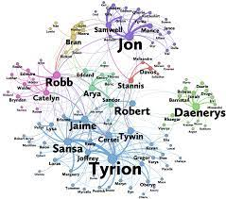
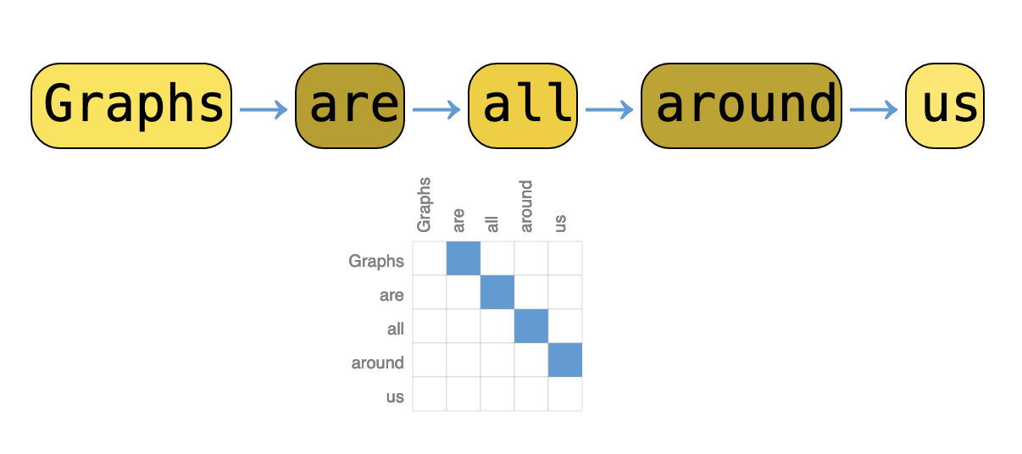
Graphs
GOT
Text

Slide 7
useful problems that can be formulated over graphs
Node Classification: Classifying individual nodes.
Graph Classification: Classifying entire graphs.
Node Clustering: Grouping together similar nodes based on connectivity.
Link Prediction: Predicting missing links.
Influence Maximization: Identifying influential nodes.

Slide 8
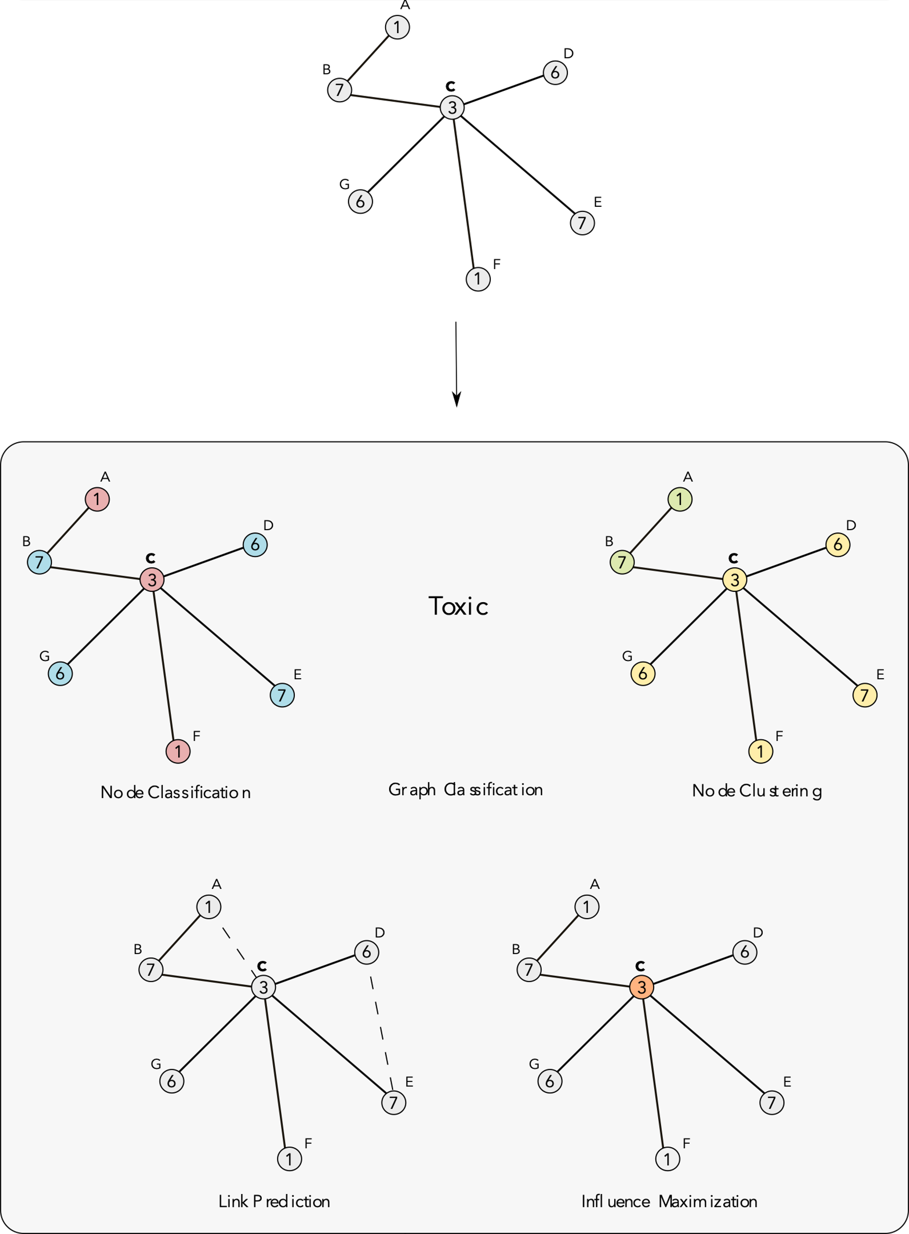
useful problems that can be formulated over graphs
regression
https://distill.pub/2021/understanding-gnns/

Slide 9
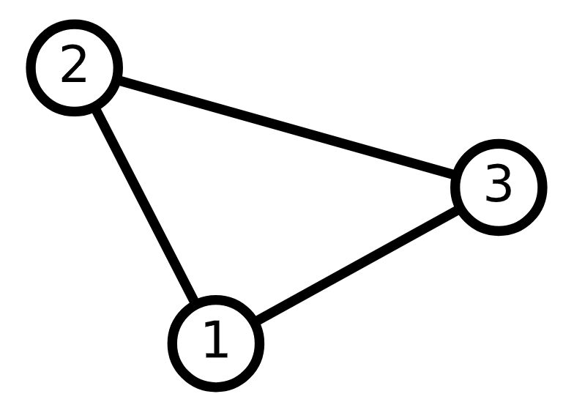
Graph-NN
Message-passing layer: operations that can deal with graphs
New graph!
→ Node information
→ Edge information

Slide 10

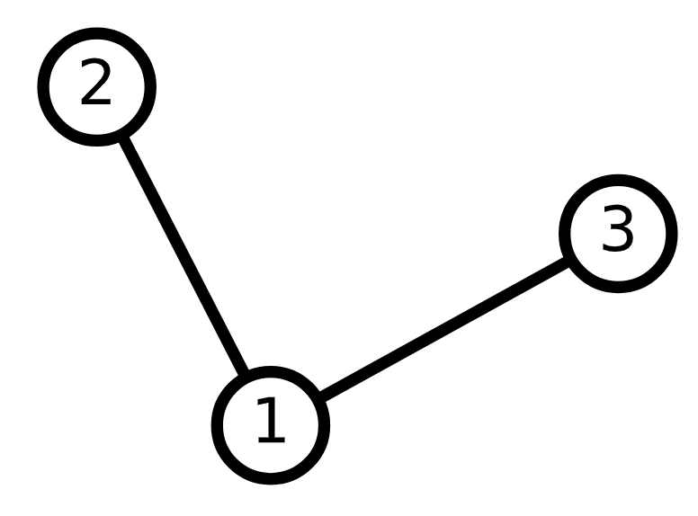
Message-passing layer
1) Aggregation of the messages from the neighboring nodes and edges
Averaging over neighbors
Can we learn new ? →
Nodes info: [[1. 0. 0.] [0. 1. 0.] [0. 0. 1.]]
Adjacency matrix: [[1. 1. 1.] [1. 1. 0.] [1. 1. 0.]] New nodes:
[[0.333 0.333 0.333]
[0.5 0.5 0. ]
[0.5 0.5 0. ]]

Slide 11

Message-passing layer
1) Aggregation of the messages from the neighboring nodes and edges
weighted average
over neighbors
Nodes info
[[1. 0. 0.]
[0. 1. 0.]
[0. 0. 1.]]
Adjacency matrix
[[1. 1. 1.]
[1. 1. 0.]
[1. 0. 1.]]
Weights
[[-1.19 0.02 -1.69]
[-0.66 -1.15 -0.64]
[-1.95 0.55 1.61]]
Averaged nodes
[[-1.27017878 -0.19143937 -0.24107242]
[-0.92953744 -0.56286759 -1.16576336]
[-1.57314651 0.28785593 -0.04277473]]

Slide 12

Message-passing layer
Aggregation of the messages from the neighboring nodes and edges
Update the node features based on the message and old features
The design of message-passing operations
is essential to learning graph representations
What is
?
Old nodes
New nodes

Slide 13
Message-passing layers
Graph convolution NN
messages from neighbors
GraphSAGE
This operations are invariant to node permutation!!!!

Slide 14
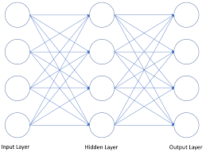
Under what circumstances a vanilla-NN is a GNN?
Input
hidden
hidden
output

Slide 15
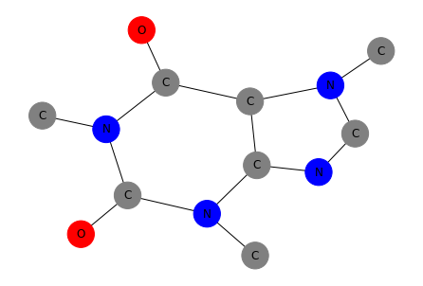
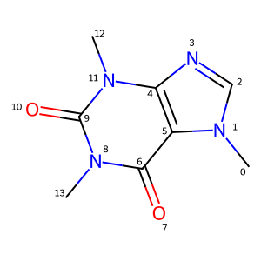



MOLECULAR GRAPH
Graph
Vertices → atoms
Edges → bonds
G = ( V, E )
Nature Machine Intelligence 3, 1023 (2021)

Slide 16

MOLECULAR GRAPH
Graph
nodes → atoms
edges → bonds
What information can we store in the nodes?
What information can we store in the edges?
atomic features:
[atom type, number of heavy atom neighbours, formal charge, hybridisation type, whether the atom is in a ring, whether the atom is aromatic, atomic mass, Van der Waals radius, and covalent radius]
bond features:
[bond type, bond is conjugated, bond is in a ring, E-Z stereochemical]
Nature Machine Intelligence 3, 1023 (2021)

Slide 17
How to turn a SMILES string into a molecular graph for Pytorch Geometric?
https://www.blopig.com/blog/2022/02/how-to-turn-a-smiles-string-into-a-molecular-graph-for-pytorch-geometric/

Slide 18
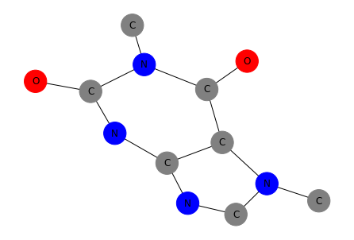

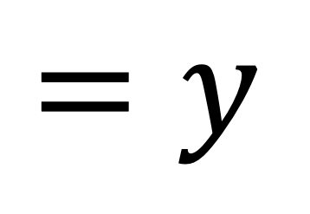
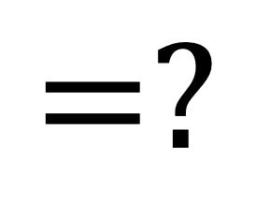
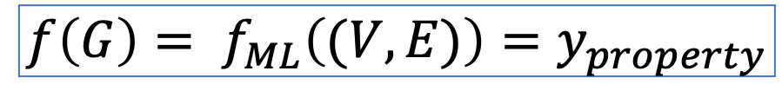

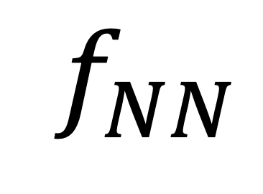

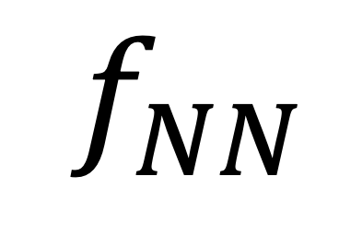
ML + MOLECULAR GRAPH
$$f\left(G\right)= f_{ML}\left((V,E)\right)=y_{property}$$
$$($$
$$)$$
$$f_{NN}$$
$$=y$$
$$($$
$$)$$
$$f_{NN}$$
$$=?$$
Paraxanthine
Nature Machine Intelligence 3, 1023 (2021)

Slide 19
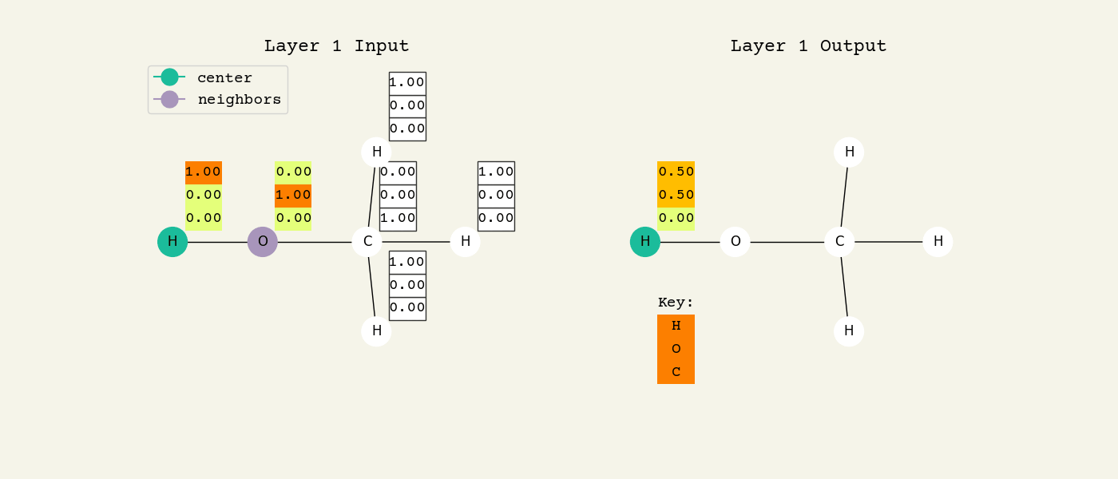
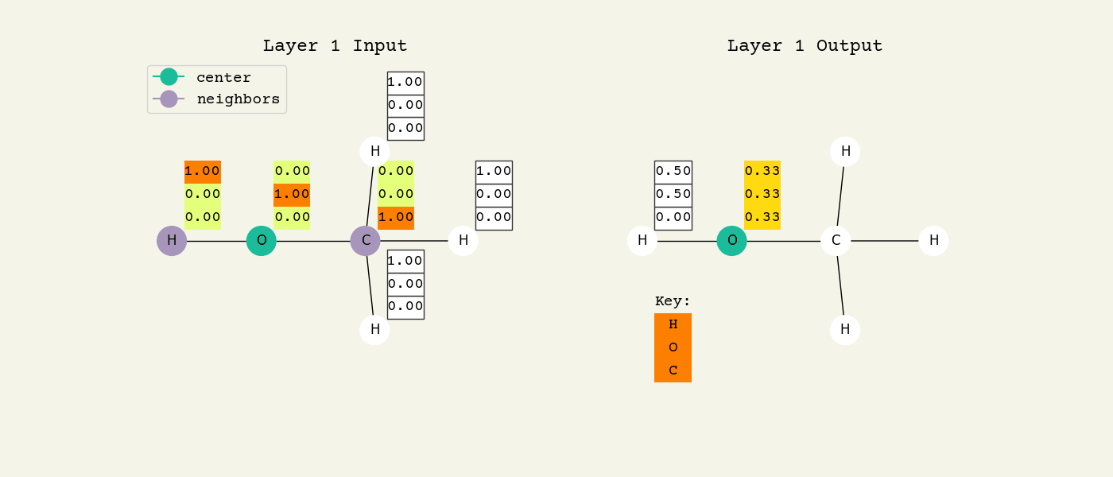
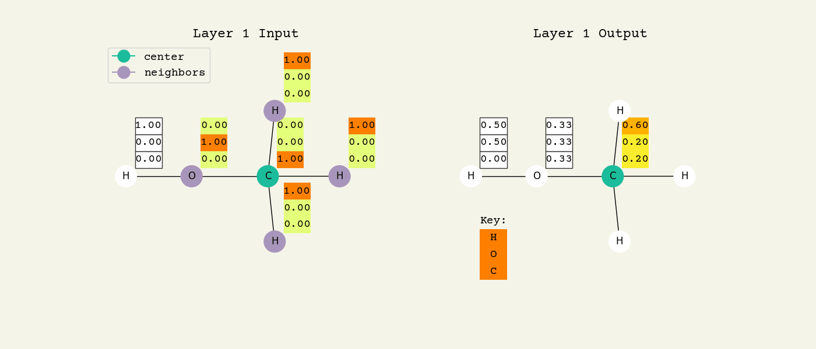
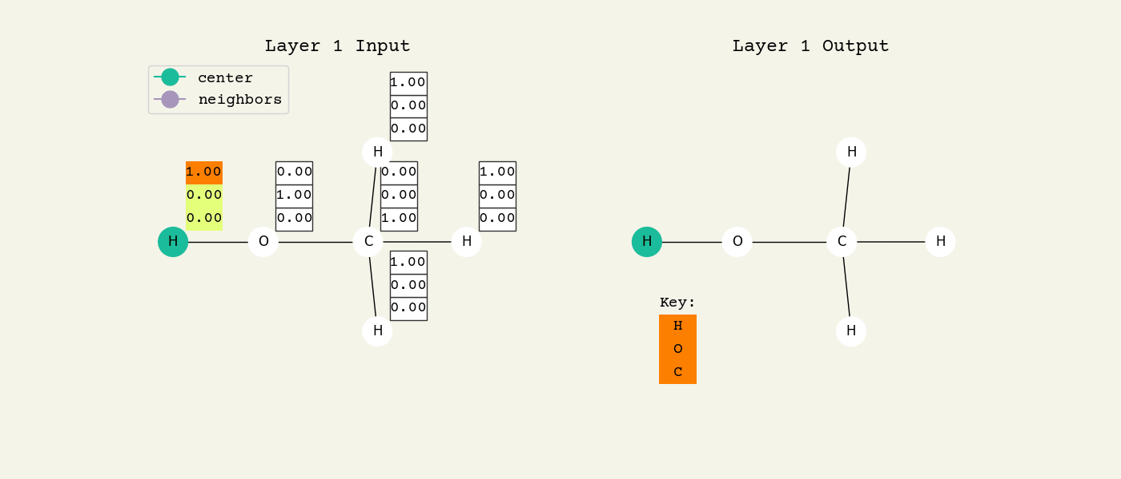
NEIGHBORS INFORMATION
(Graph Neural Networks)
https://github.com/whitead/dmol-book

Slide 20
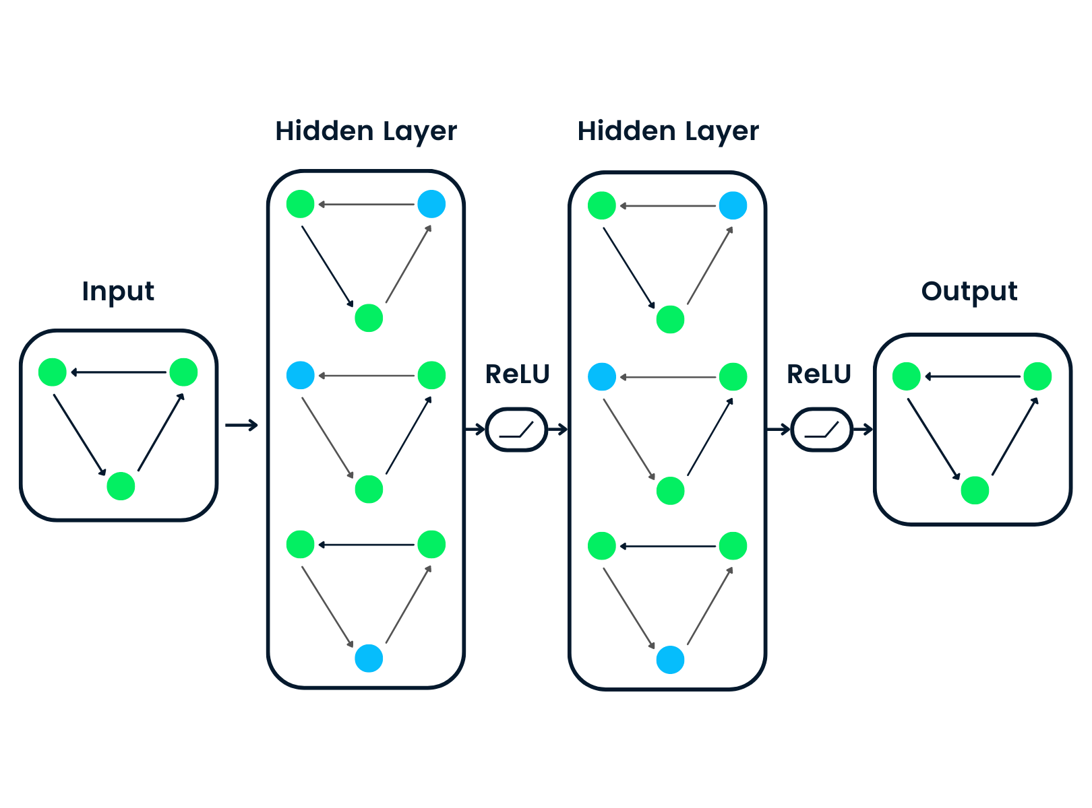
Prediction?
(Graph Neural Networks)
https://www.datacamp.com/tutorial/comprehensive-introduction-graph-neural-networks-gnns-tutorial

Slide 21
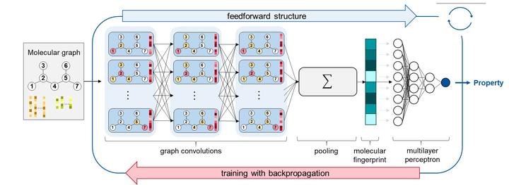
Prediction
(Graph Neural Networks)
Read out operation
use the “learned” features as input to a last prediction model
Learned graph
Energy & fuels, 34(9), 11395-11407 (2020).

Slide 22
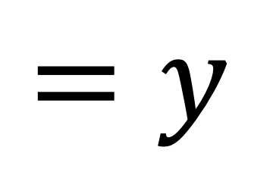
ML + MOLECULAR GRAPH
$$f\left(G\right)= f_{ML}\left((V,E)\right)=y_{property}$$
$$($$
$$)$$
$$f_{NN}$$
$$=y$$
$$($$
$$)$$
$$f_{NN}$$
$$=y$$
Paraxanthine
Nature Machine Intelligence 3, 1023 (2021)

Slide 23
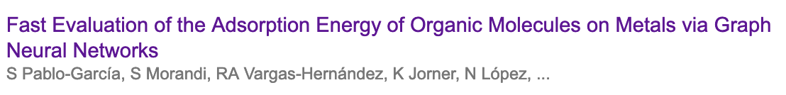
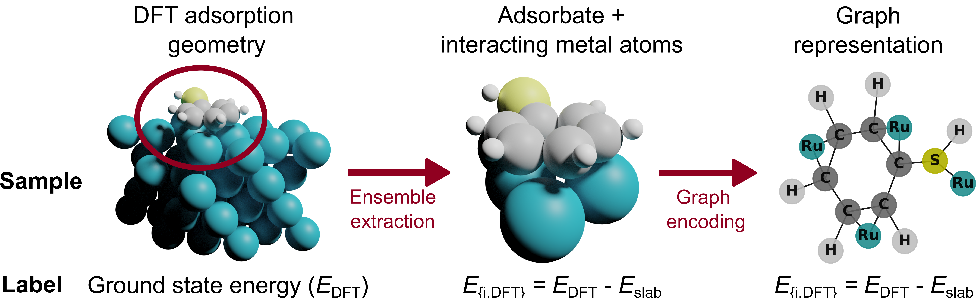
https://doi.org/10.26434/chemrxiv-2022-m719x
Catalysis

Slide 24
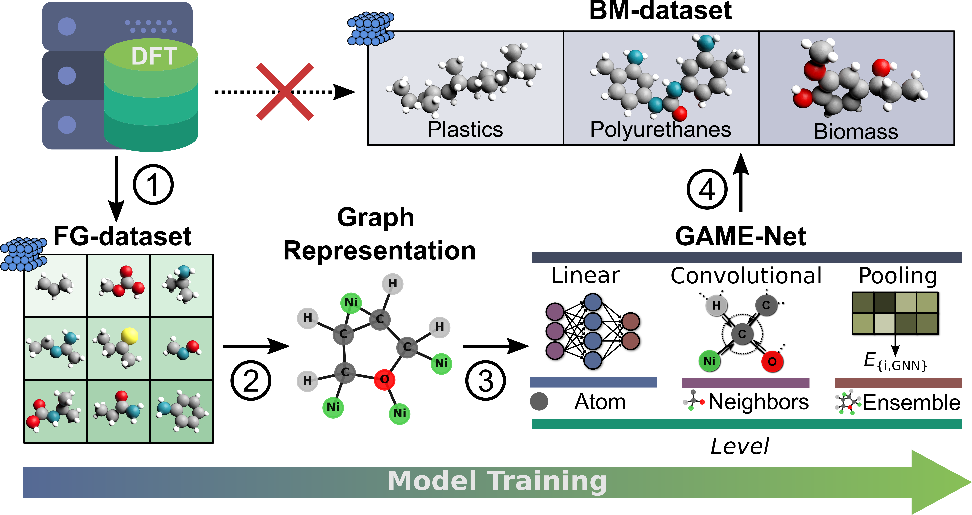
PIPELINE
(big molecules)
small molecules
https://doi.org/10.26434/chemrxiv-2022-m719x

Slide 25
RESULTS (big molecules)
Goal: To generate a model capable of predicting the adsorption energy for large molecules.
5 molecules
5 molecules
5 molecules
milliseconds prediction vs hours!!

Slide 26
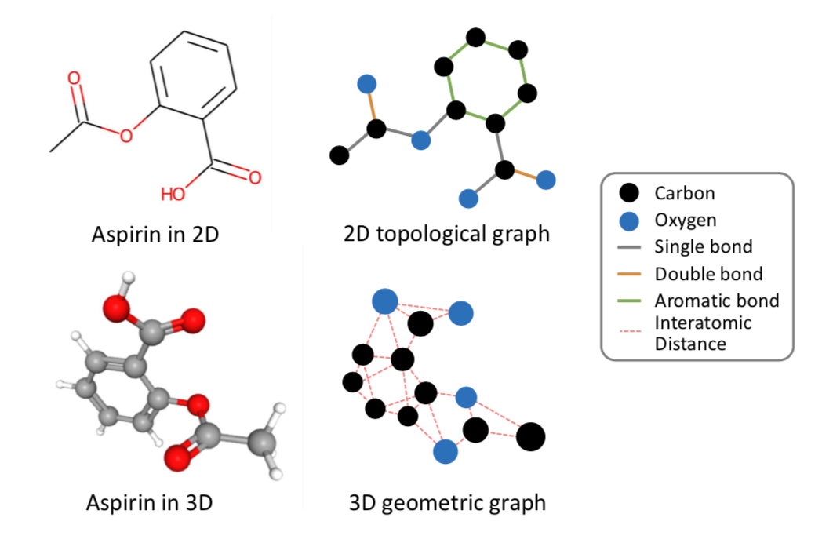
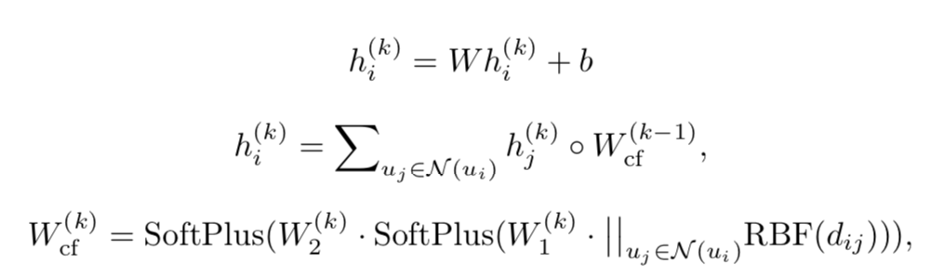
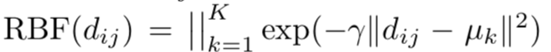
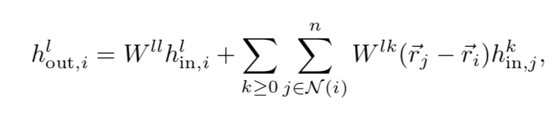
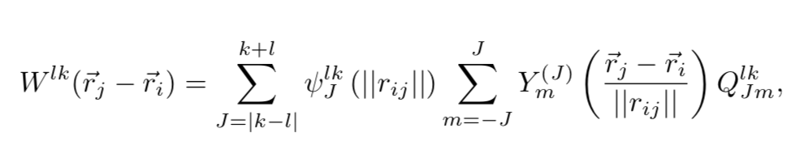
3D-GNN
Design message passing functions that is translational and rotational invariant
SchNet
SO(3) equivariant layer

Slide 27
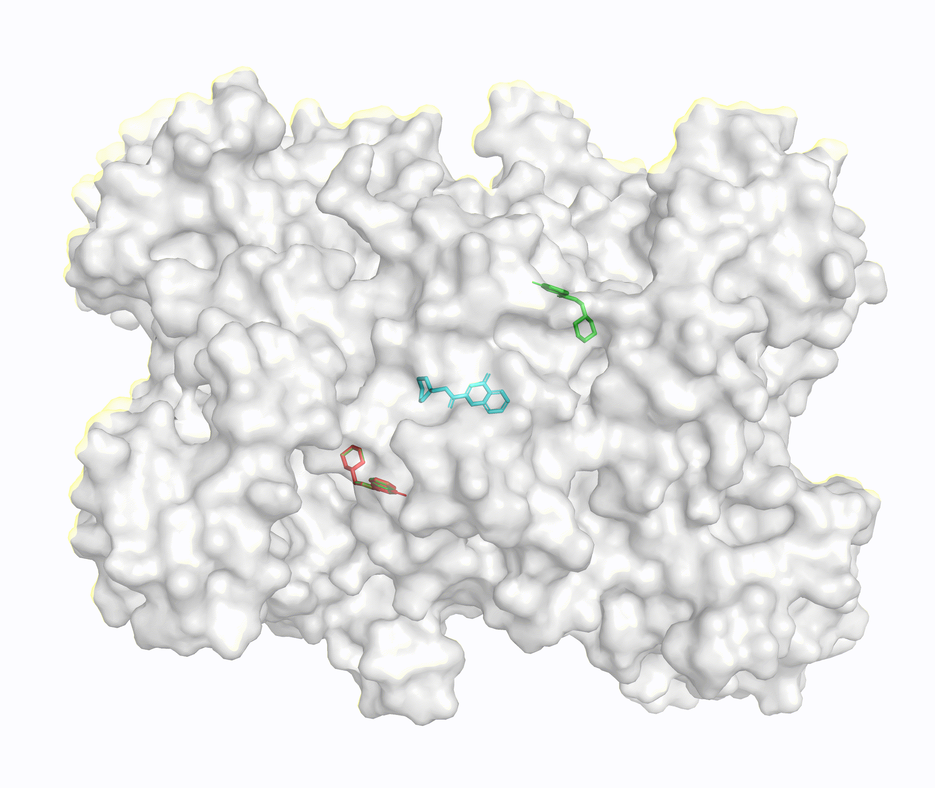
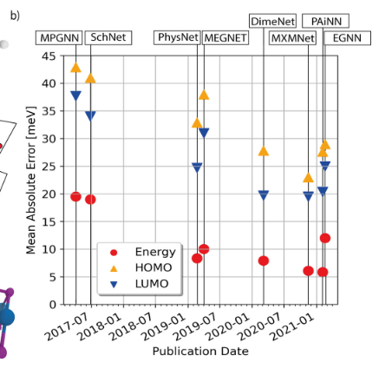
GNN in Chemistry
Graph neural networks for materials science and chemistry
DiffDock: Diffusion Steps, Twists, and
Turns for Molecular Docking
https://github.com/gcorso/DiffDock

